Slide 1
Unit 4

Slide 2
rotaton

Slide 3
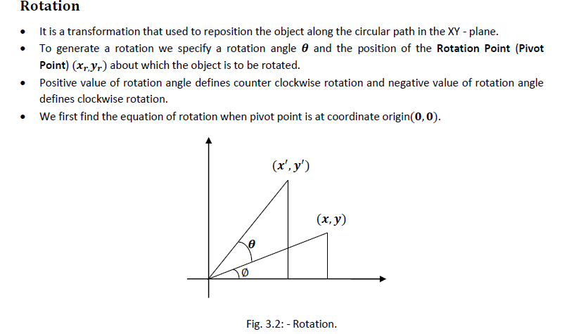

Slide 4
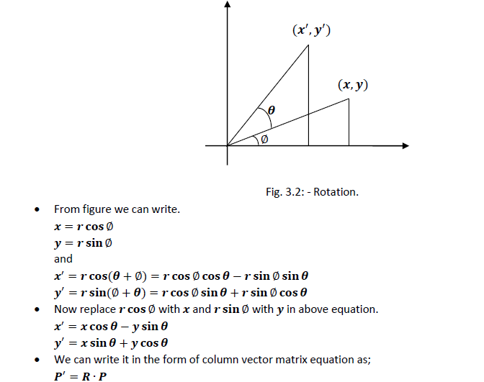


Slide 5
example

Slide 6


Slide 7
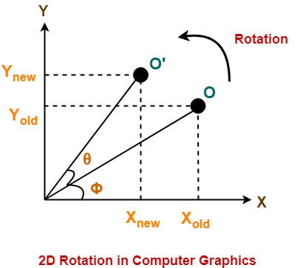

Slide 8
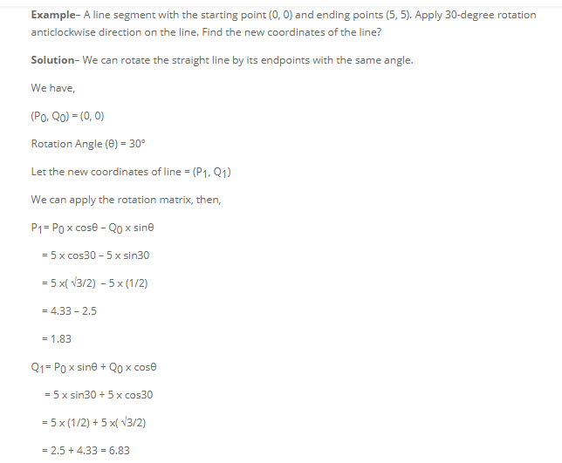

Slide 9
